Slide 1
PREDICTIVE PARSER

Slide 2
AGENDA
Finding the First and Follow Sets for a given grammar.
Constructing the parsing table with the help of the first and follow sets.
The desired output is the Parsing table along with the First and Follow Sets

Slide 3
ABSTRACT
Predictive Parser is also another method that implements the technique of Top- Down parsing without Backtracking.
A predictive parser is an effective technique of executing recursive-descent parsing by managing the stack of activation records, particularly.
Predictive parser has the following components:
Input buffer
Stack
Parsing Table

Slide 4
INTRODUCTION
A syntax analyzer or parser takes the input from a lexical analyzer in the form of token streams. The parser analyzes the source code (token stream) against the production rules to detect any errors in the code.
There are two types of Parsers: Top Down and Bottom Up
The LL(1) Parser is a Top Down Parser that does not require any back-tracking.
It is also called a Predictive or Non-Recursive Parser.

Slide 5
In an LL(1) Parser, the first L stands for parsing the input from left to right, the second L stands for left-most derivation and 1 represents the number of lookaheads. An LL Parser accepts LL Grammar.
Verifying whether a given grammar is LL(1) includes the following steps:
Computation of First and Follow Sets
Constructing the Predictive Parsing Table
Checking if the Parsing Table has multiple entries in any given cell.

Slide 6
MODULE DESCRIPTION
Algorithm to construct Predictive Parsing Table
Algorithm
Input − Context-Free Grammar G
Output − Predictive Parsing Table M
Method
For the production A → α of Grammar G.
For each terminal, a in FIRST (𝛼) add A → α to M [A, a].
If ε is in FIRST (α), and b is in FOLLOW (A), then add A → α to M[A, b].
If ε is in FIRST (α), and $ is in FOLLOW (A), then add A → α to M[A, $].
All remaining entries in Table M are errors.

Slide 7
Following are the steps to perform Predictive Parsing Table
Elimination of Left Recursion
Left Factoring
Computation of FIRST & FOLLOW
Construction of Predictive Parsing Table
Parse the Input String

Slide 8
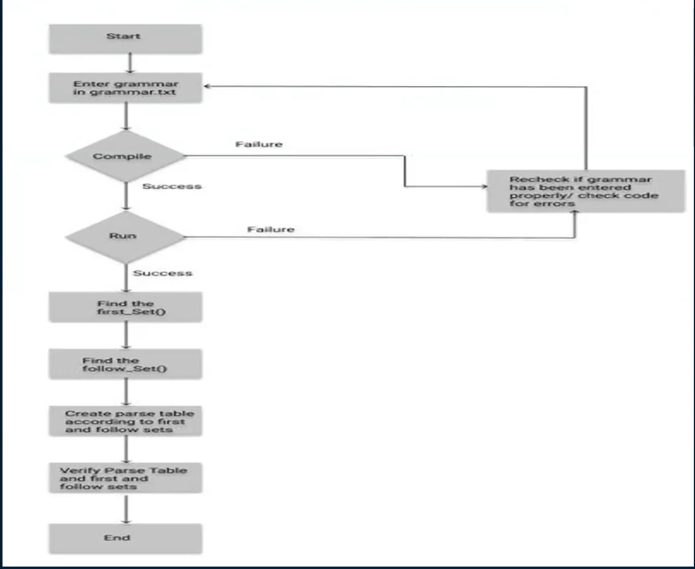
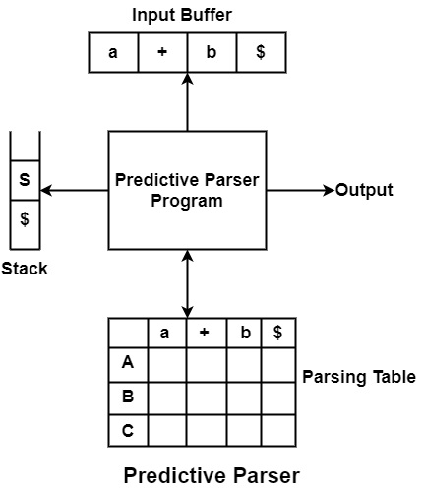

Slide 9
CONCLUSION
The final output is an LL(1) parsing table which is generated with a generated item set fed on it.
The grammar for the input has been already assumed and entered in the code itself.
The parser generates LL(1) sets of items and display that.

Slide 10
THANK YOU

